Slide 1
TASK 1: SOLVING ING THE VULNERABILITIES OF XSS LABS AT PORTSWIGGER
STEPS TO BE FOLLOWED :
STEP1 : Open Virtualbox and Login to Kali linux
STEP2 : Open firefox in linux and search portswigger
STEP3 : Sign upto portswigger and open the profile
STEP4 : After opening the profile, open the vulnerability list
STEP5 : Now check wheather the xss vulnaribility labs are available or not
STEP6 : Start solving the vulnerabilities labs with the help of payloads
STEP7 : Payloads can be downloaded from github
STEP8 : Solved any of the given 5 vulneravilities. COMPLETED

Slide 2
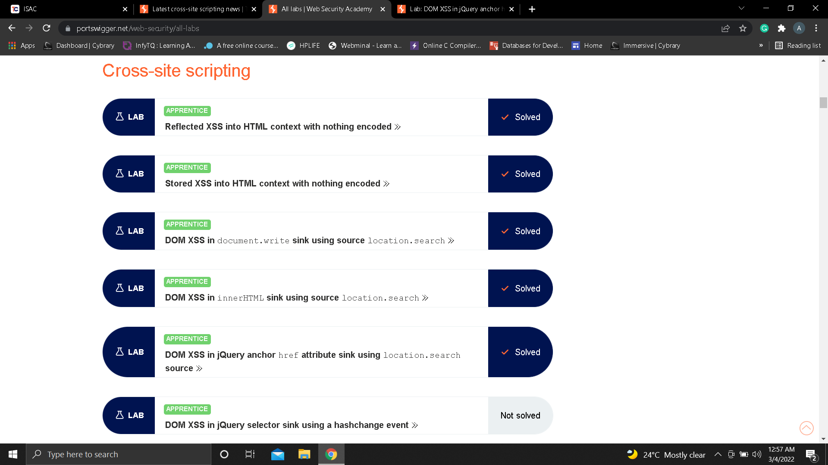

Slide 3
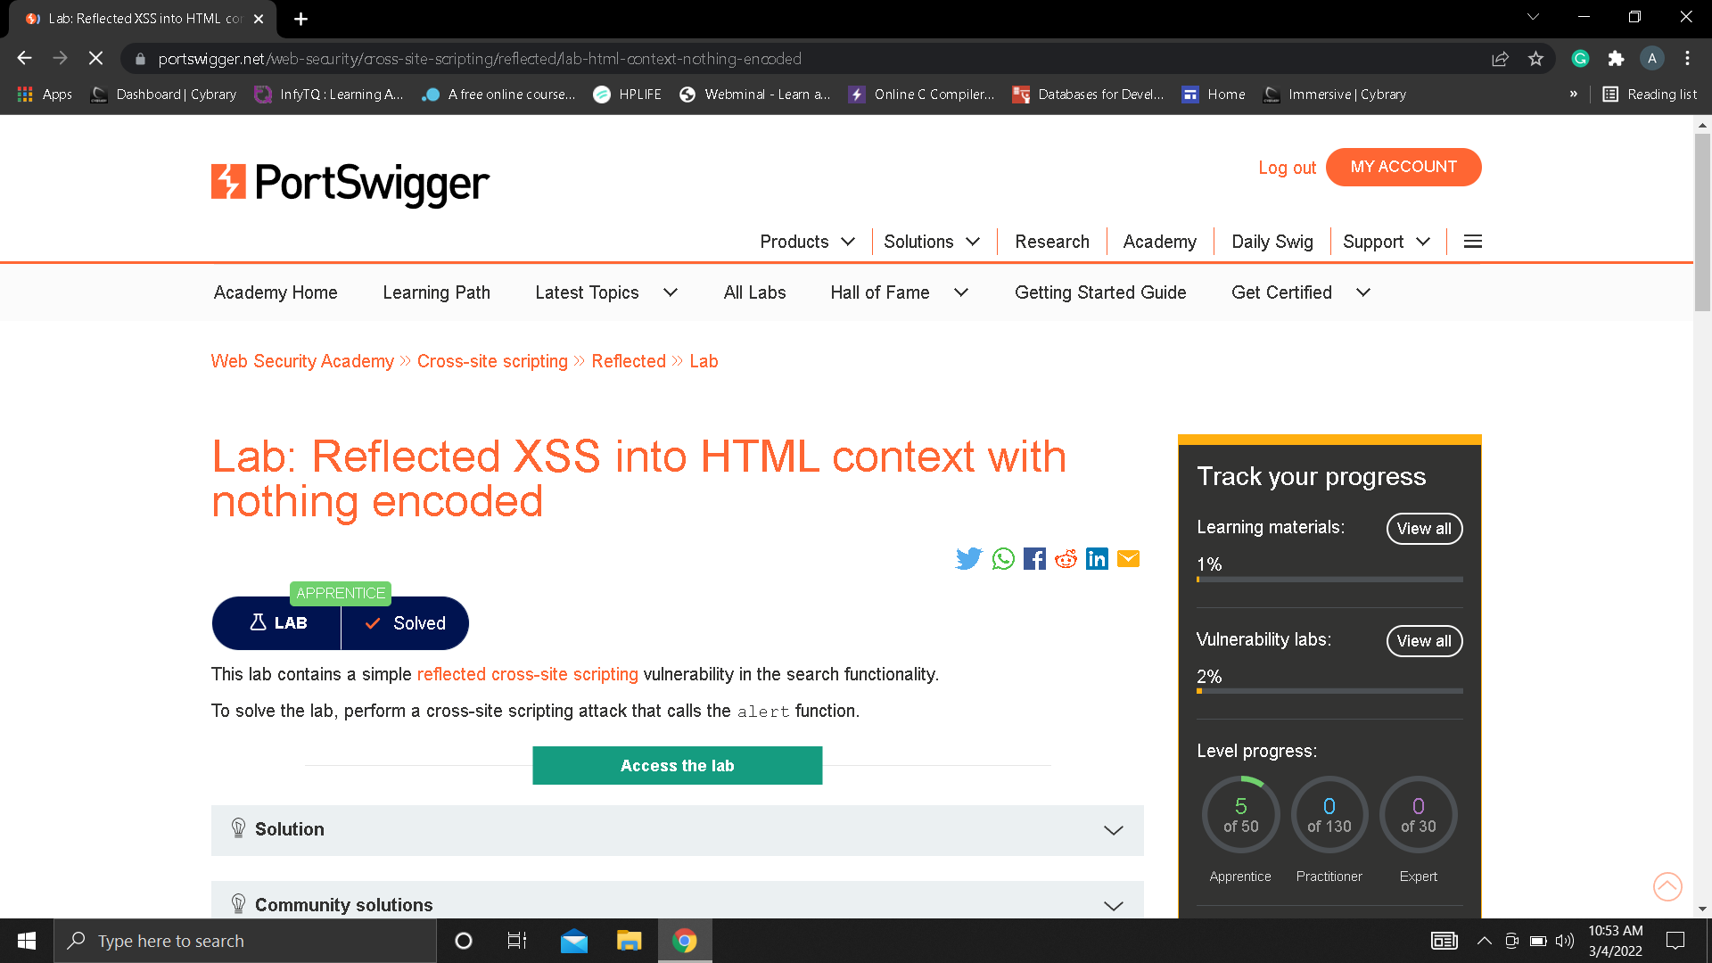

Slide 4


Slide 5
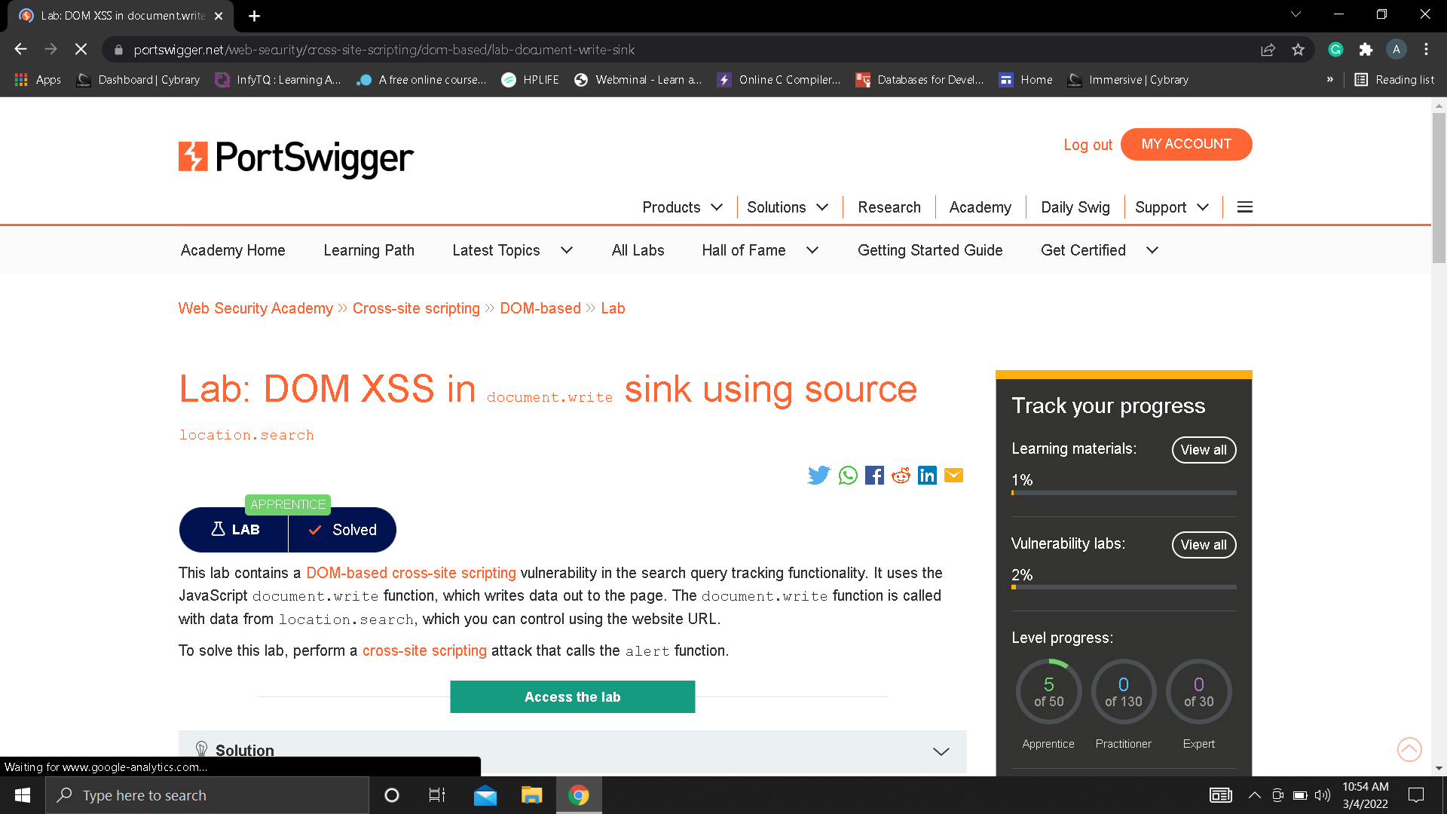

Slide 6


Slide 7
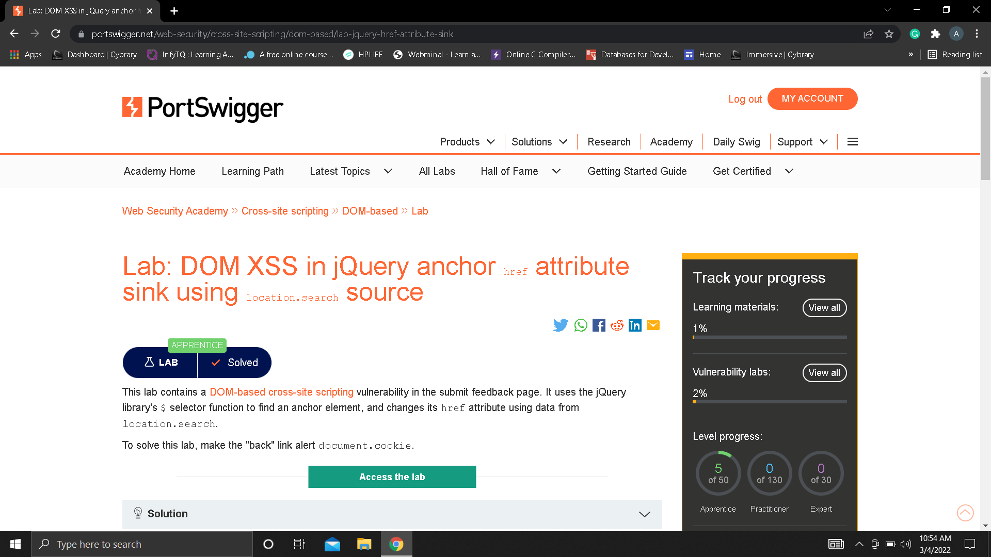

Slide 8
THANK YOU

